Slide 1
The NexCalendar
Group3
LI Haotian, Ronnie
Wong ShuKi
Shen Menghan

Slide 2
1. Motivation
Motivation

Slide 3
The current Calendar system is unnecessarily complex
Huge trouble when matching month to weeks.
High cost on printing / educating …
Motivation

Slide 4
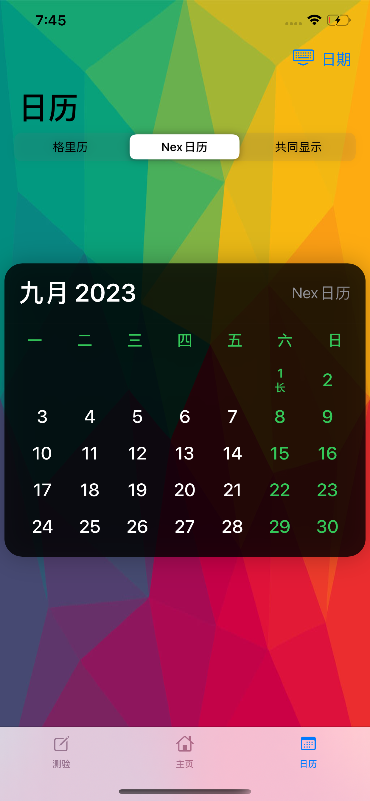
Motivation

Slide 5

Business Model

Slide 6
2. Business Model
Business Model

Slide 7
Fun and smooth transitions between 2 calendar systems
Rewarding progress by doing quizzes
Check difference whenever needed to strengthen the memorizing process
Business Model

Slide 8
3. Feature Description
Feature Description

Slide 9
- Display of the NexCalendar
- Display of the Gregorian Calendar
- Comparing displays
- Date Picker
Feature Description

Slide 10
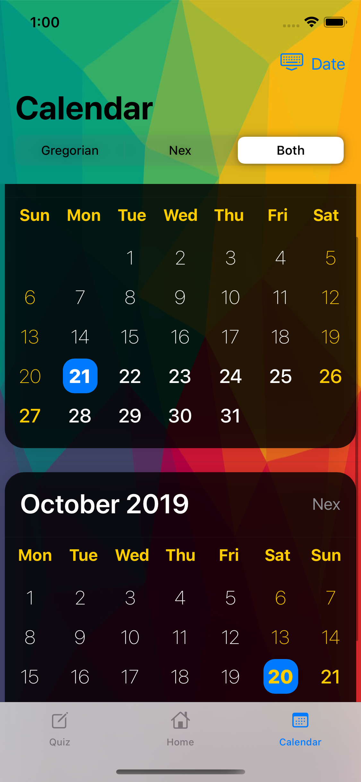
Feature Description

Slide 11
Full tutorials of the background knowledge
With Star / Unstar feature
Scroll Animation on tutorial cards
Feature Description

Slide 12
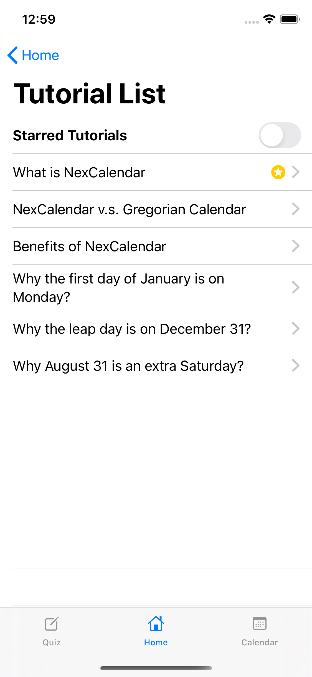
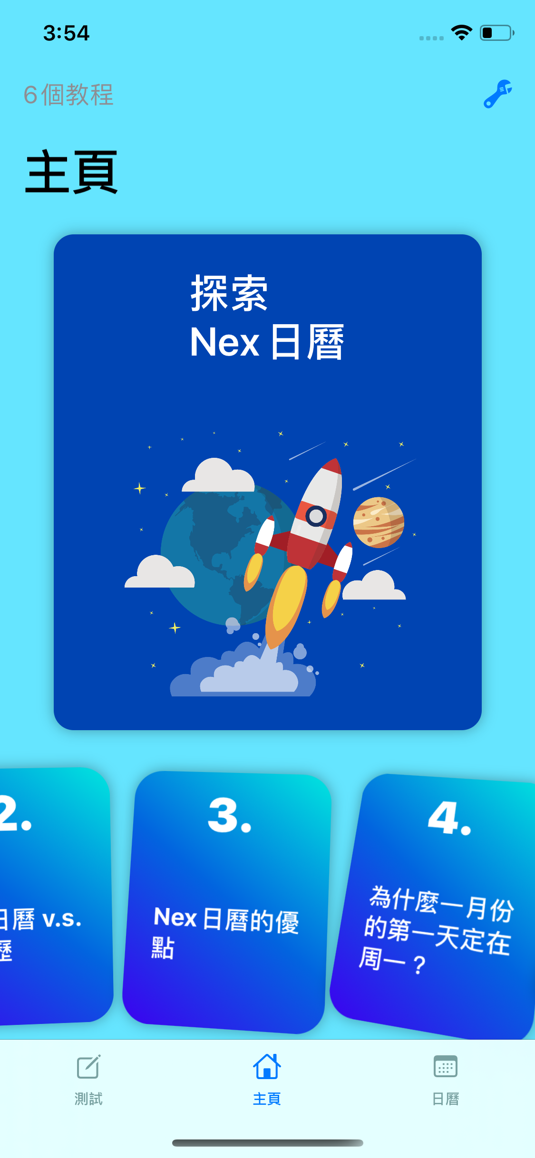
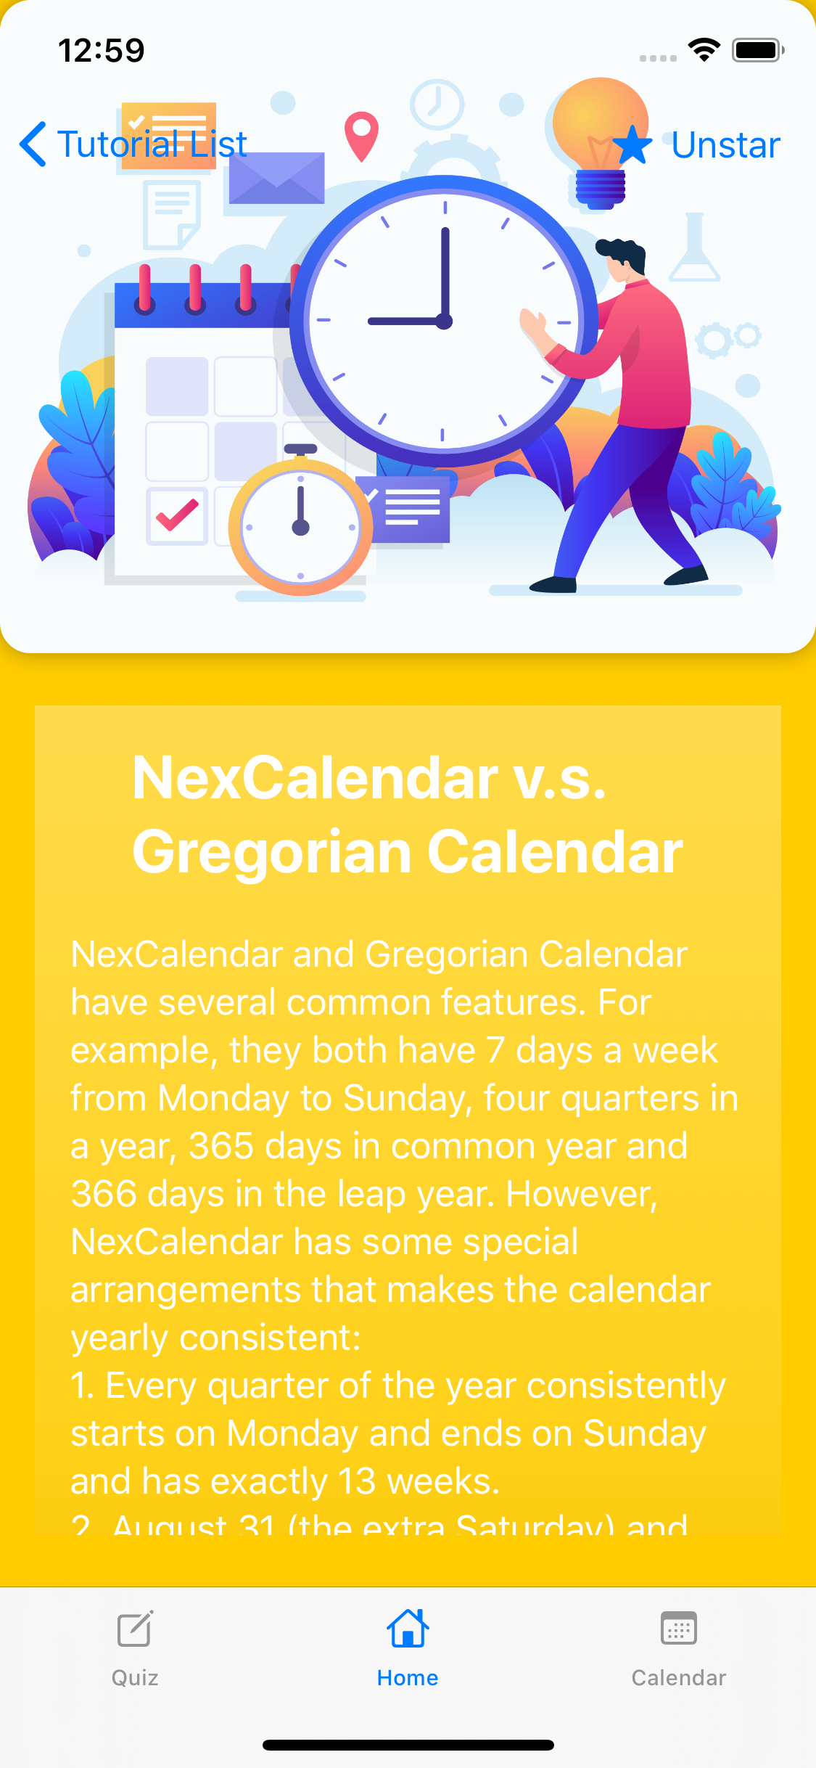
Feature Description

Slide 13
Quizzes Mode with rich question base
Instant scoring system.
Answer checking
Feature Description

Slide 14
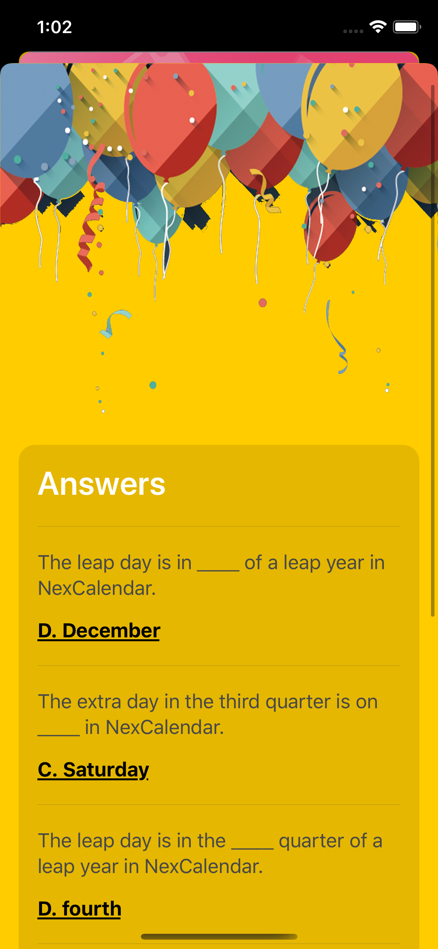
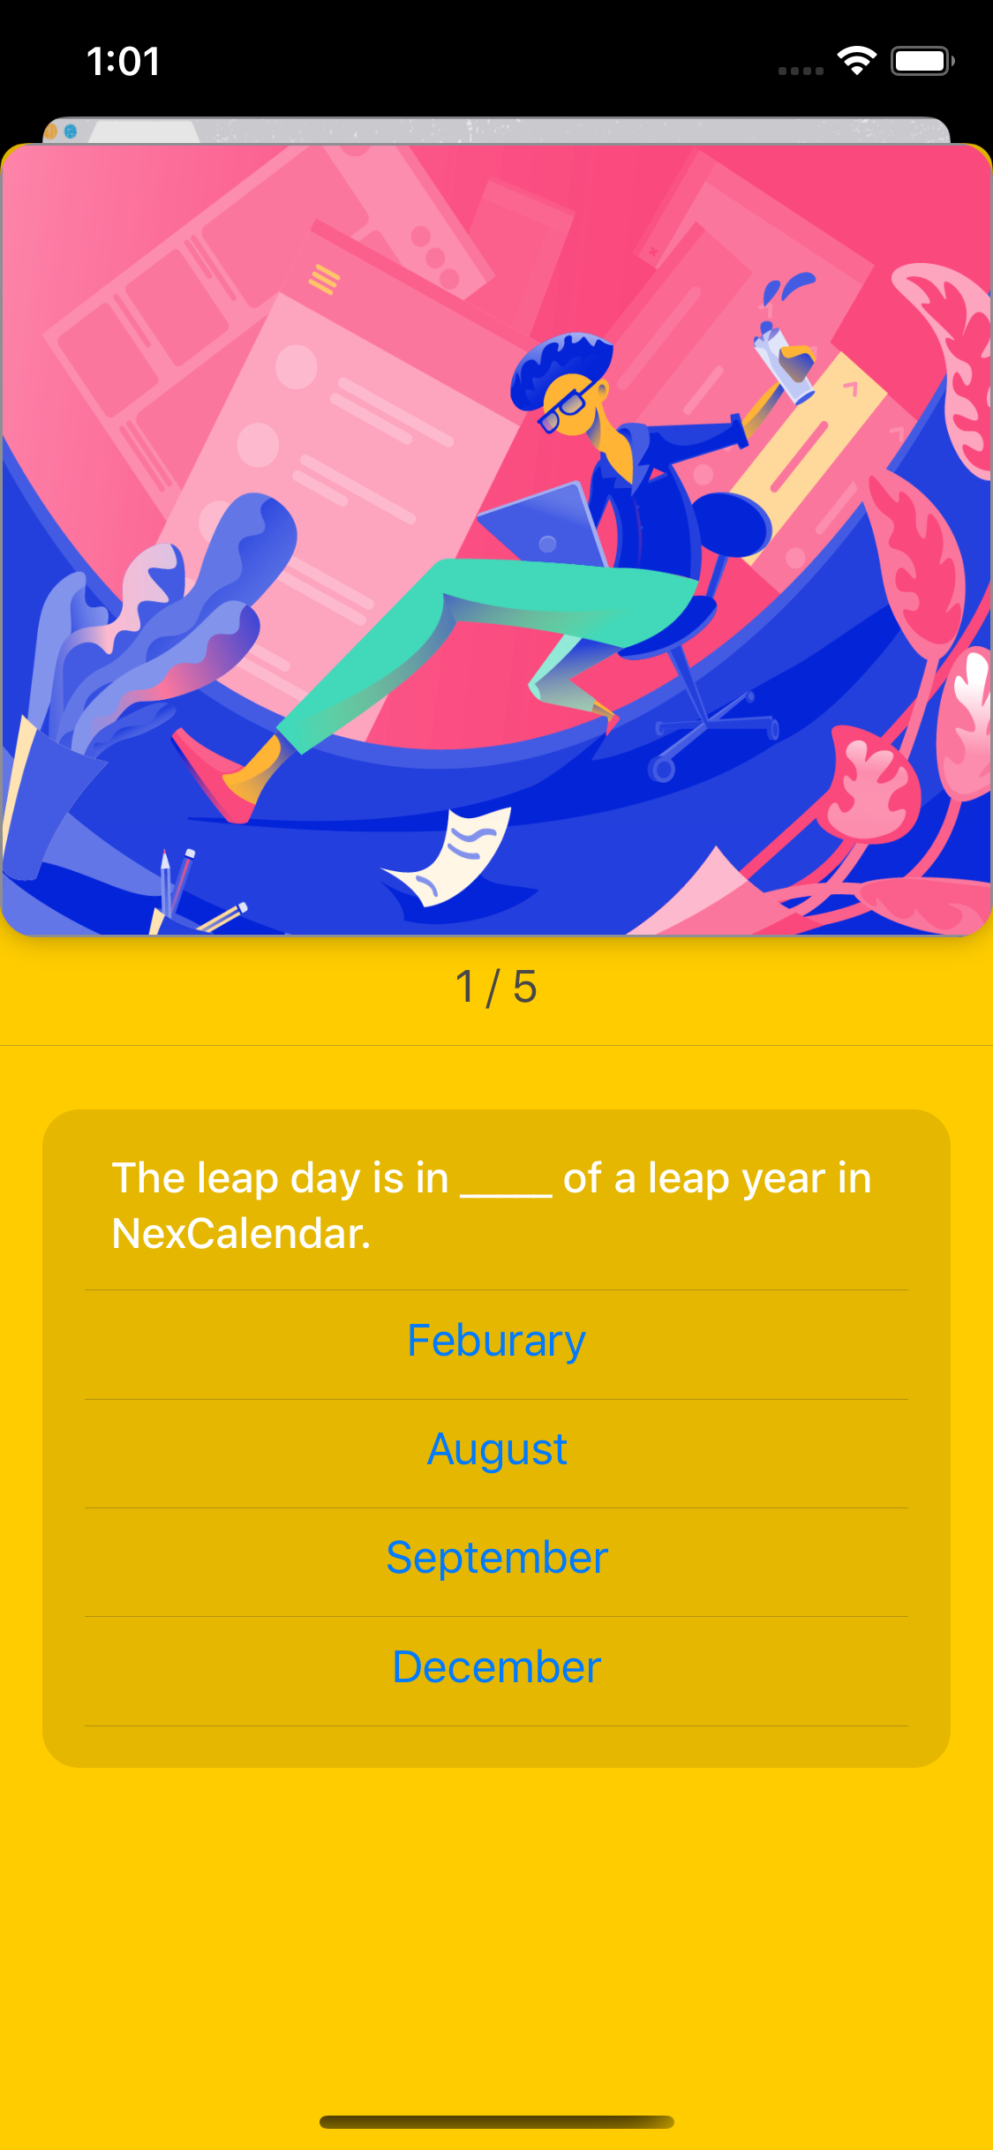
Feature Description

Slide 15
Localization. En 简 繁
Different display theme
Developed in new SwiftUI
Feature Description

Slide 16
4. App Demo
App demo

Slide 17
Thank you
Group3
LI Haotian, Ronnie

